Slide 2
Unjumble this word
ELOV
LOVE
Notes:
Unjumble this word

Slide 3
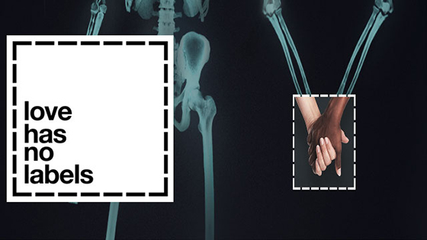
Watch: Love has no labels
Notes:
https://www.youtube.com/watch?v=PnDgZuGIhHs

Slide 4
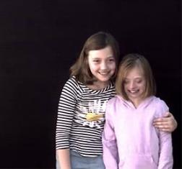
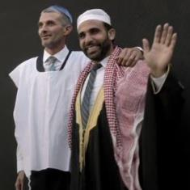
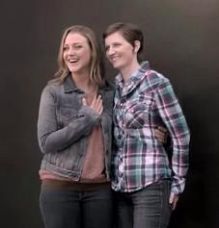
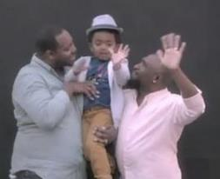
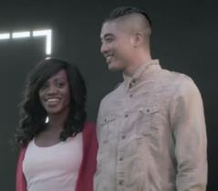
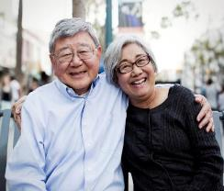
Discuss: We saw lots of pairs of people. Who do you remember seeing?

Slide 5
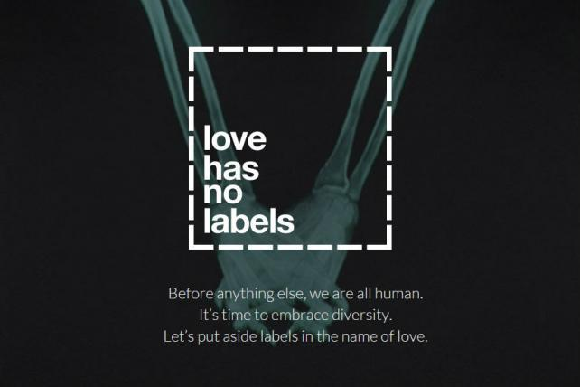
Discuss: what is the main message of the video?

Slide 6
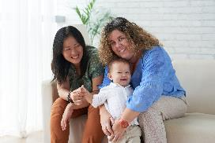
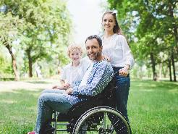
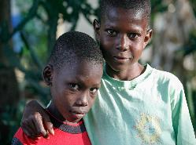
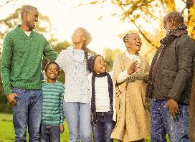
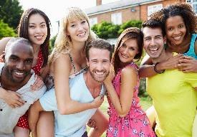
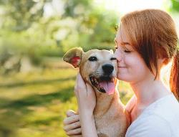
Discuss: what different types of love can you see?
Notes:
Parents and child
Partner – can be woman and woman (lesbian), man and man (gay) man and woman (heterosexual) or people can fall in love with men or women (bisexual)

Slide 7
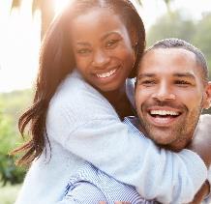
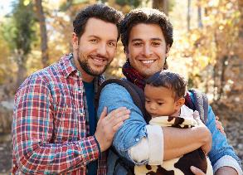
Discuss: How many differences can you see?
Notes:
Sexual orientation – heterosexual and gay
Mixed race
Some families have children

Slide 8
Discuss: How many similarities can you see?
Notes:
Smiling
Together
Happy
Love each other
Have fun
Trust
Support

Slide 9
Reflect: What does love mean to you?
Notes:
Pupils come up with their own definition of love, that is inclusive of everyone. Teacher comes up with their own and shares as an example if modelling is needed.
Extension idea:
All pupils go back to their class, re-watch the video and re-cap discussions on different types of love. Pupils write and draw their own definitions in a red love heart. Use these hearts to make a display on love and different families.

Slide 10
www.diversityrolemodels.org
info@diversityrolemodels.org

